Slide 1

Wealth APIs in Ultrahack
Tomi Johansson, Wealth Management Solution Architect
Tomi.johansson@op.fi

Slide 2
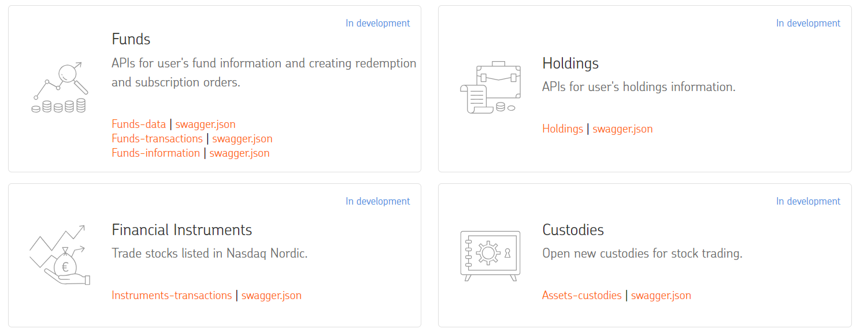
Our APIs in Wealth

Slide 3
Few words about the domain..
Instruments / Securities – Holds some type of monetary value. It represents an ownership position in a publicly-traded corporation (via stock) or in index fund (via ETF)
Nasdaq Nordics - Marketplaces where you can make trades, every marketplace has own set of instrument / securities which can be buy or sell. One of the marketplaces in Nasdaq is the OMX Helsinki which is the main stock exhange trading market in Finland. It includes for example the Nokia stock trading.
ISIN code – Standard International Securities Identification Number (ISIN) uniquely identifies the stock or ETF, example Nokia FI0009000681
Custody / Servicepackage – When customer is doing trading the OP is responsible to hold the instruments / securities on behalf of the customer in Custody / Servicepackage. This is like a stock wallet for the customer
Account number – Money account which is included to custody for buying the stocks
Transactions – When start the trading towards the market, you make the buy or sell transaction where you tell what kind of offer you put in.
Orders – You can check what is the status of transactions

Slide 4
Basic use case in API.. Setup customer
Your App
GET https://sandbox.apis.op-palvelut.fi/instruments/mgmt/v1/instruments
OP Wealth API
[{"instrument": {
"isinCode": "FI0009000681",
"marketPlace": "HEL",
"currency": "EUR",
"name": "NOKIA"
}….]
POST https://sandbox.apis.op-palvelut.fi/custodies/mgmt/v1/servicepackage
{
"accountNumber": "FI4859986910000280"
}
{
"custodyNumber": "0000049833",
"accountNumber": "FI4859986910000280"
}

Slide 5
Basic use case in API.. Start trading
Your App
POST https://sandbox.apis.op-palvelut.fi/instruments/mgmt/v1/instruments/FI0009000681/orders
{
"amount": 10,
"accountNumber": "FI4859986910000280",
"custody": " 0000049833",
"type": "BUY"
}
OP Wealth API
{
"orderIdentifier": "584102076850"
}
GET https://sandbox.apis.op-palvelut.fi/instruments/mgmt/v1/orders
[{
"currency": "EUR",
"instrumentName": "NOKIA",
"isinCode": "FI0009000681",
"marketPlace": “HEL",
"orderIdentifier": " 584102076850",
"purchasedInstruments": “10",
"staus": "ACTUALIZED",
"totalAmount": “50.1",
"type": "BUY",
"value": “4.91"
},….]

Slide 6
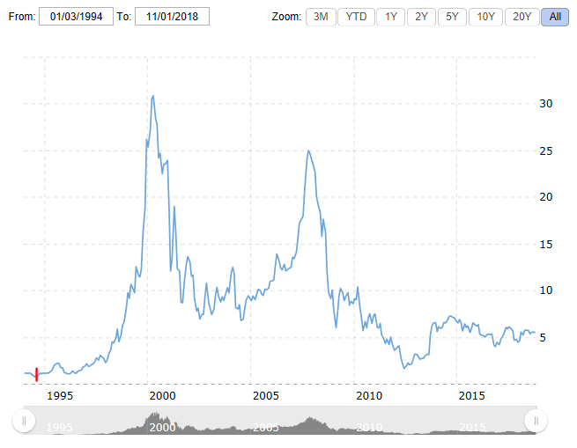
Basic use case in API.. Holdings
Your App
OP Wealth API
GET https://sandbox.apis.op-palvelut.fi/holdings/info/v1/holdings
"instrumentHoldings": [
{
“instrumentName": “NOKIA",
"isinCode": " FI0009000681 ",
"marketValue": 49149.1,
"holdingsItem": [
{
"marketValue": 49.1,
"purchaseValue": 49.1
},
{
"marketValue": 49100.0,
"purchaseValue": 7800.0
},
],
"changeOfValue": 41300.1,
"purchaseValue": 7849.1,
"changeAsPercentage": 626.2
}
],…
}
Notes:
Jule 1994 one stock 0.78€ -> 10 000 stocks total 7800€
Tecno bubble Apr 2000 one stock 30.87€ -> 308 700€ / 3957%

Slide 7
External market data sources which can be combined to make these what if cases
Pure trading information APIs
https://iextrading.com/developer/
https://www.alphavantage.co/
https://blog.rapidapi.com/best-finance-apis/
News APIs
https://www.xignite.com/Product/xignitenews/1#/productoverview

